Slide 1
Line Limit Preserving Power System Equivalent
ECE 590I
Wonhyeok Jang
Work with Prof. Overbye, Saurav Mohapatra & Hao Zhu

Slide 2
Contents
Introduction
Preliminaries
Cases
Algorithm
Examples
Conclusions

Slide 3
Introduction
Equivalent power system
A model system with fewer nodes and branches than the original
Purpose of equivalent
More efficient simulation
Without sacrificing too much fidelity of simulation results of the original

Slide 4
Introduction
Ward equivalent (Kron’s reduction)
Traditional method to equivalence power system network models
Loses desired attributes of the original system
Objective of work
Develop equivalents that preserve desired attributes, the line limits in this work, of the original system

Slide 5
Preliminary – Line limits
Thermal line limits are intended to limit
Temperature attained by the energized conductors
Resulting sag
Loss of tensile strength
Limits are calculated where conductor sag is at minimum allowable clearance
Geographical condition
Climate condition

Slide 6
Preliminary - Kron’s reduction
When a bus k between bus i and j is equivalenced
First term on RHS is admittance of existing line
Second term on RHS is admittance of equivalent line
Theses equivalent lines have no limits
Goal is to assign limits to theses equivalent lines that preserve desired attribute of the original

Slide 7
Preliminary - PTDF
Power Transfer Distribution Factor
Linear approximation of the impact of power flowing on each line w.r.t the amount t of an arbitrary basic transaction w
∆f_{l}: fraction of power transfer flowing on line l
∆t: specific amount of transaction w
Basic transaction $w≜\left\{m, n, t\right\}$

Slide 8
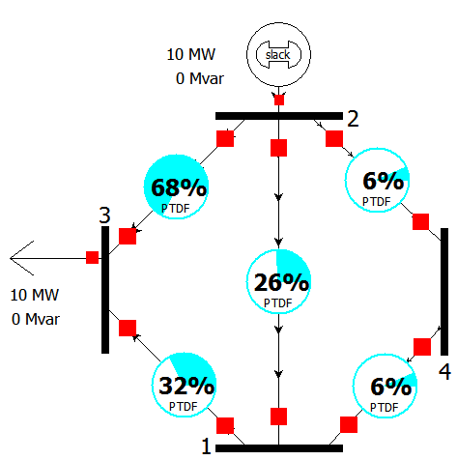
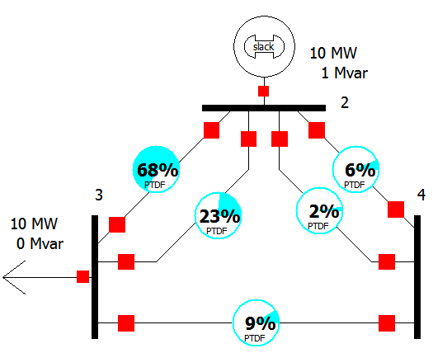
Preliminary - PTDF
PTDFs on the retained lines are not affected by equivalencing
Original system with PTDFs from 2 to 3
Equivalent system with PTDFs from 2 to 3

Slide 9
Preliminary - MPT
Desired attribute to preserve by assigning limits
Maximum power transfer (MPT) between retained buses match that for the same buses in the original
MPT between bus i and j can be calculated with PTDF
${MPT}_{ij}=min⁡\left(\frac{{Line limit}_{l}}{{PTDF}_{ij,l}}\right)$
l: each line of the system
Need to match for MPTs between all the first neighbor buses of the bus being eliminated

Slide 10
General Case
Bus E, between bus A and B, is going to be eliminated
Need to calculate the new limit for the equivalent line between bus A and B

Slide 11
Special Case
Series Combination
If two lines are in series and the node joining them is equivalenced, then the total limit must be the lower of the two limits
$Limit t=min⁡(Limit 1, Limit 2, . . . , Limit n)$

Slide 12
Special Case
Parallel Combination
New limit is determined by which line in the parallel lines is binding
$Limit t=min⁡(Lim1\frac{Z1}{Zt},Lim2\frac{Z2}{Zt}, . . ., Limn\frac{Zn}{Zt})$

Slide 13
Algorithm
Sequentially as each bus is being equivalenced
Combine limits of parallel lines
Calculate PTDFs between the first neighbor buses
Calculate MPT between the first neighbor buses, only considering the lines that are being eliminated
Limits on the retained lines do not need to be considered since they remain the same
Determine limits for equivalent lines so the MPTs of the equivalent match that in the original

Slide 14
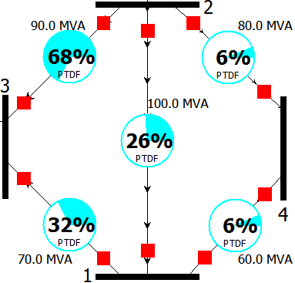
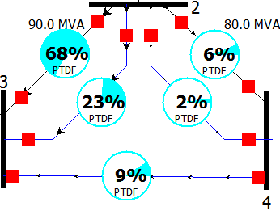
Ex - 4 bus system
MPTs in the original system
MPT 2-3: 216.7 MW (1-3 binding)
MPT 2-4: 171.7 MW (1-4 binding)
MPT 3-4: 144.9 MW (1-4 binding)
For 2-3 direction, eq. line limits are
Lim23 >= 216.7*0.234 = 50.7 MW
Lim24 >= 216.7*0.024 = 5.2 MW
Lim34 >= 216.7*0.088 = 19.1 MW
Original system with PTDF from 2 to 3
Reduced system with PTDF from 2 to 3

Slide 15
Ex - 4 bus system (Exact solution)
 | Directions
 | 2-3 | 2-4 | 3-4
Eq Lim 23 >= | 50.7 MW | 4.8 MW | 29.8 MW
Eq Lim 24 >= | 5.2 MW | 41.4 MW | 31.4 MW
Eq Lim 34 >= | 19.1 MW | 18.7 MW | 28.5 MW
Often, solution is just the largest in each row
This works when each column has one solution
There are cases with no exact solutions when equality constraints for at least one direction may not by satisfied

Slide 16
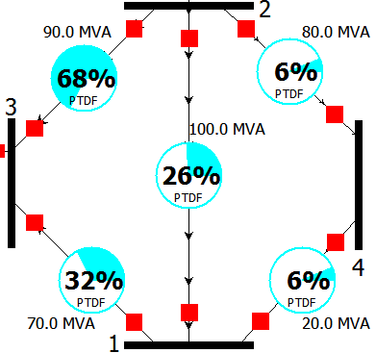
Ex - 4 bus system (No solution 1 - Overestimate)
When there’s no solution -> Bound the solution
Line limit 1-4 is reduced from 60 MVA to 20 MVA
Others are all the same with the original
MPTs in the original system
MPT 2-3: 216.7 MW (1-3 binding)
MPT 2-4: 57.2 MW (1-4 binding)
MPT 3-4: 48.3 MW (1-4 binding)
Original system with PTDF from 2 to 3

Slide 17
Ex - 4 bus system (No solution 1 - Overestimate)
 | Directions
 | 2-3 | 2-4 | 3-4
Eq Lim 23 >= | 50.7 MW | 1.6 MW | 9.9 MW
Eq Lim 24 >= | 5.2 MW | 13.8 MW | 10.5 MW
Eq Lim 34 >= | 19.1 MW | 6.2 MW | 9.5 MW
All of the inequality constraints are satisfied for each row
But power flow in direction 3-4 is overestimated since no entries in its column is enforced

Slide 18
Ex - 4 bus system (No solution 2 - underestimate)
We make sure power flow in each direction is less than the original MPT
Then at least one inequality constraints would be violated and this will underestimate the MPT
We define “limit violation cost” for each entry of the matrix, which is the sum of violations for all entries in each row

Slide 19
Ex - 4 bus system (No solution 2 - underestimate)
Original eq. line limit matrix
 | Directions
 | 2-3 | 2-4 | 3-4
Eq Lim 23 >= | 50.7 MW | 1.6 MW | 9.9 MW
Eq Lim 24 >= | 5.2 MW | 13.8 MW | 10.5 MW
Eq Lim 34 >= | 19.1 MW | 6.2 MW | 9.5 MW
Limit violation cost matrix
 | Directions
 | 2-3 | 2-4 | 3-4
Eq Lim 23 | 0 | 57.4 | 40.8
Eq Lim 24 | 13.9 | 0 | 3.3
Eq Lim 34 | 0 | 16.2 | 9.6
For the first row, the 2-3 entry is 0 since it involves no limit violations;
the 2-4 entry 57.4 = (50.7 – 1.6) + (9.9 – 1.6)
The 3-4 entry 40.8 = (50.7 – 9.9)

Slide 20
Ex - 4 bus system (No solution 2 - underestimate)
Minimum matching problem – Hungarian algorithm
Choose one entry in each row and each column that minimizes the sum of the violation costs
Limit violation cost matrix
 | Directions
 | 2-3 | 2-4 | 3-4
Eq Lim 23 | 0 | 57.4 | 40.8
Eq Lim 24 | 13.9 | 0 | 3.3
Eq Lim 34 | 0 | 16.2 | 9.6
Underestimate solution
 | Directions
 | 2-3 | 2-4 | 3-4
Eq Lim 23 >= | 50.7 MW | 1.6 MW | 9.9 MW
Eq Lim 24 >= | 5.2 MW | 13.8 MW | 10.5 MW
Eq Lim 34 >= | 19.1 MW | 6.2 MW | 9.5 MW

Slide 21
Conclusions
Able to determine limits for eq. lines
In case of no exact limits, we bound the limits
When the number of first neighbor buses increase, then there’s rapid increase of the number of computation
There’s a certain value of line limits that turns a exact solution case to no exact solution case
Investigation of which factor changes solution types is needed

Slide 22
Thank you!

Slide 23
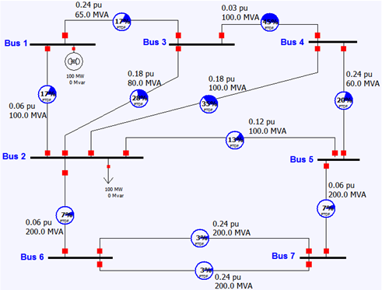
Ex - 7 bus system
Original 7-bus system
Eliminating bus 3

Slide 24
Ex - 7 bus system
Determination of equivalent line limits
 | 1-2 | 1-4 | 2-4
Eqv Line 1-2 | 11.2 MW | 4.1 MW | 1.2 MW
Eqv Line 1-4 | 53.8 MW | 56.8 MW | 38.7 MW
Eqv Line 2-4 | 17.8 MW | 43.2 MW | 61.3 MW
MPT comparison of lines being eliminated between 7-bus and 6-bus
 | 1-2 | 1-4 | 2-4
Original 7-bus | 412.1 MW (line 1-3 binding) | 187.1 MW (line 3-4 binding) | 223.7 MW (line 3-4 binding)
Reduced 6-bus | 412.1 MW (Eq line 1-2 binding) | 187.1 MW (Eq line 1-4 binding) | 223.7 MW (Eq line 2-4 binding)
Error rate (%) | 0.0 | 0.0 | 0.0
MPT comparison of all lines between 7-bus and 6-bus
 | 1-2 | 1-4 | 2-4
Original 7-bus | 118.7 MW (line 1-2 binding) | 148.2 MW (line 1-2 binding) | 223.7 MW (line 3-4 binding)
Reduced 6-bus | 118.7 MW (line 1-2 binding) | 148.2 MW (line 1-2 binding) | 223.7 MW (Eq line 2-4 binding)
Error rate (%) | 0.0 | 0.0 | 0.0

Slide 25
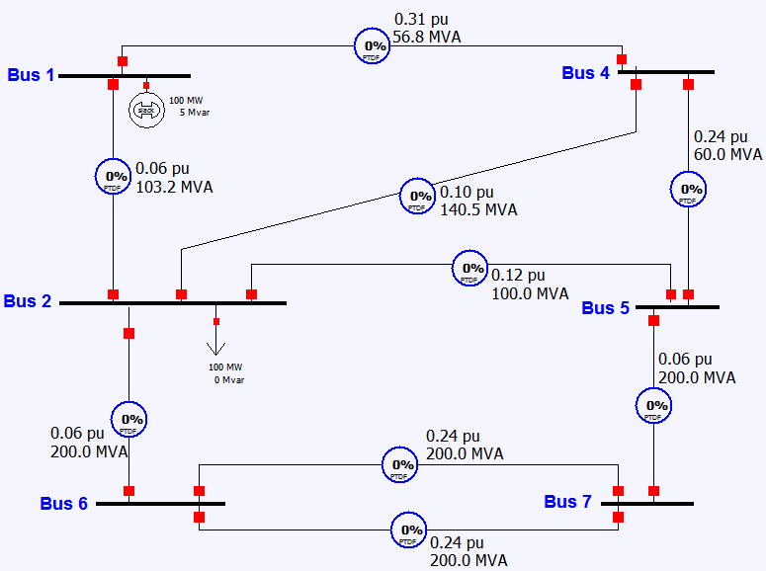
Ex - 7 bus system
Equivalent 6-bus system
Eliminating bus 5

Slide 26
Ex - 7 bus system
Determination of equivalent line limits
 | 2-4 | 2-7 | 4-7
Eqv Line 2-4 | 22.9 MW | 3.6 MW | 10.6 MW
Eqv Line 2-7 | 17.1 MW | 96.4 MW | 56.5 MW
Eqv Line 4-7 | 37.1 MW | 41.1 MW | 49.4 MW
MPT comparison of lines being eliminated between 6-bus and 5-bus
 | 2-4 | 2-7 | 4-7
Reduced 6-bus | 301.4 MW (line 4-5 binding) | 250.1 MW (line 2-5 binding) | 171.8 MW (line 4-5 binding)
Reduced 5-bus | 301.4 MW (Eq line 2-4 binding) | 250.1 MW (Eq line 2-7 binding) | 171.8 MW (Eq line 4-7 binding)
Error rate (%) | 0.0 | 0.0 | 0.0
MPT comparison of all lines between 6-bus and 5-bus
 | 2-4 | 2-7 | 4-7
Reduced 6-bus | 223.7 MW (line 2-4 binding) | 250.1 MW (line 2-5 binding) | 171.8 MW (line 4-5 binding)
Reduced 5-bus | 223.7 MW (line 2-4 binding) | 250.1 MW (Eq line 2-7 binding) | 171.8 MW (Eq line 4-7 binding)
Error rate (%) | 0.0 | 0.0 | 0.0

Slide 27
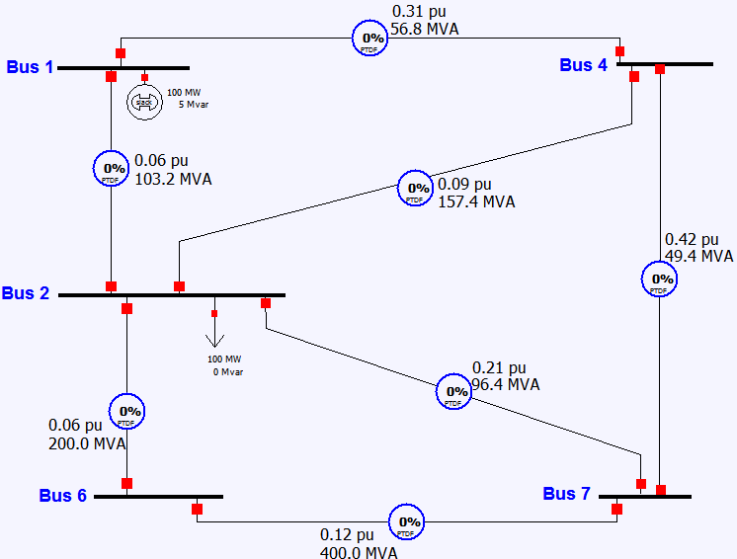
Ex - 7 bus system
Equivalent 5-bus system
Eliminating bus 2

Slide 28
Ex - 7 bus system (overestimate)
Determination of equivalent line limits
 | 1-4 | 1-6 | 1-7 | 4-6 | 4-7 | 6-7
Eqv Line 1-4 | 53.4 MW | 20.2 MW | 23.8 MW | 0.1 MW | 45.9 MW | 9.6 MW
Eqv Line 1-6 | 37.5 MW | 68.2 MW | 53.4 MW | 75.0 MW | 49.6 MW | 50.4 MW
Eqv Line 1-7 | 12.4 MW | 14.9 MW | 26.0 MW | 9.6 MW | 35.1 MW | 32.6 MW
Eqv Line 4-6 | 27.6 MW | 24.3 MW | 11.2 MW | 92.6 MW | 76.3 MW | 41.7 MW
Eqv Line 4-7 | 6.8 MW | 4.0 MW | 10.1 MW | 18.9 MW | 35.2 MW | 18.3 MW
Eqv Line 6-7 | 1.6 MW | 4.5 MW | 10.4 MW | 11.4 MW | 20.2 MW | 45.5 MW

Slide 29
Ex - 7 bus system (overestimate)
MPT comparison of lines being eliminated between 5-bus and 4-bus
 | 1-4 | 1-6 | 1-7 | 4-6 | 4-7 | 6-7
Reduced 5-bus | 148.2 MW (line 1-2 binding) | 120.2 MW (line 1-2 binding) | 123.3 MW (line 1-2 binding) | 238.6 MW (line 2-4 binding) | 275.3 MW (line 2-4 binding) | 375.1 MW (line 2-7 binding)
Reduced 4-bus | 148.2 MW (Eq line 1-4 binding) | 132.2 MW (Eq line 1-6 binding) | 166.4 MW (Eq line 1-7 binding) | 238.6 MW (Eq line 1-6 binding) | 275.3 MW (Eq line 1-7 & Eq line 4-7 binding) | 375.1 MW (Eq line 6-7 binding)
Error rate (%) | 0.0 | 10.0 | 34.9 | 0.0 | 0.0 | 0.0
MPT comparison of all lines between 5-bus and 4-bus
 | 1-4 | 1-6 | 1-7 | 4-6 | 4-7 | 6-7
Reduced 5-bus | 148.2 MW (line 1-2 binding) | 120.2 MW (line 1-2 binding) | 123.3 MW (line 1-2 binding) | 238.6 MW (line 2-4 binding) | 171.8 MW (line 4-7 binding) | 375.1 MW (line 2-7 binding)
Reduced 4-bus | 148.2 MW (Eq line 1-4 binding) | 132.2 MW (Eq line 1-6 binding) | 154.9 MW (Eq line 1-7 binding) | 238.6 MW (Eq line 1-6 binding) | 171.8 MW (line 4-7 binding) | 375.1 MW (Eq line 6-7 binding)
Error rate (%) | 0.0 | 10.0 | 34.9 | 0.0 | 0.0 | 0.0

Slide 30
Ex - 7 bus system (underestimate)
Determination of equivalent line limits
 | 1-4 | 1-6 | 1-7 | 4-6 | 4-7 | 6-7
Eqv Line 1-4 | 53.4 MW | 20.2 MW | 23.8 MW | 0.1 MW | 45.9 MW | 9.6 MW
Eqv Line 1-6 | 37.5 MW | 68.2 MW | 53.4 MW | 75.0 MW | 49.6 MW | 50.4 MW
Eqv Line 1-7 | 12.4 MW | 14.9 MW | 26.0 MW | 9.6 MW | 35.1 MW | 32.6 MW
Eqv Line 4-6 | 27.6 MW | 24.3 MW | 11.2 MW | 92.6 MW | 76.3 MW | 41.7 MW
Eqv Line 4-7 | 6.8 MW | 4.0 MW | 10.1 MW | 18.9 MW | 35.2 MW | 18.3 MW
Eqv Line 6-7 | 1.6 MW | 4.5 MW | 10.4 MW | 11.4 MW | 20.2 MW | 45.5 MW
Limit violation costs
 | 1-4 | 1-6 | 1-7 | 4-6 | 4-7 | 6-7
Eqv Line 1-4 | 0.0 | 62.7 | 51.6 | 152.3 | 7.5 | 104.8
Eqv Line 1-6 | 96.9 | 6.8 | 36.4 | 0.0 | 36.6 | 45.5
Eqv Line 1-7 | 59.1 | 49.0 | 15.7 | 72.7 | 0.0 | 2.4
Eqv Line 4-6 | 127.7 | 141.2 | 206.5 | 0.0 | 16.3 | 85.6
Eqv Line 4-7 | 55.1 | 69.5 | 42.1 | 16.3 | 0.0 | 17.5
Eqv Line 6-7 | 84.1 | 69.7 | 46.0 | 42.9 | 25.3 | 0.0

Slide 31
Ex - 7 bus system (underestimate)
Find minimum sum of limit violation costs using Hungarian algorithm
 | 1-4 | 1-6 | 1-7 | 4-6 | 4-7 | 6-7
Eqv Line 1-4 | 0.00 | 55.86 | 35.88 | 152.28 | 7.47 | 104.80 | 0
Eqv Line 1-6 | 96.94 | 0.00 | 20.66 | 0.00 | 36.63 | 45.51 | 0
Eqv Line 1-7 | 59.12 | 42.26 | 0.00 | 72.73 | 0.00 | 2.44 | 0
Eqv Line 4-6 | 127.69 | 134.38 | 190.79 | 0.00 | 16.33 | 85.61 | 0
Eqv Line 4-7 | 55.11 | 62.68 | 26.42 | 16.33 | 0.00 | 17.54 | 0
Eqv Line 6-7 | 84.13 | 62.94 | 30.32 | 42.94 | 25.29 | 0.00 | 0
 | 0 | 6.79 | 15.72 | 0 | 0 | 0 | 22.51

Slide 32
Ex - 7 bus system (underestimate)
Find minimum sum of limit violation costs using Hungarian algorithm
 | 1-4 | 1-6 | 1-7 | 4-6 | 4-7 | 6-7
Eqv Line 1-4 | 0.00 | 55.86 | 35.88 | 152.28 | 7.47 | 104.80 | 0
Eqv Line 1-6 | 96.94 | 0.00 | 20.66 | 0.00 | 36.63 | 45.51 | 0
Eqv Line 1-7 | 59.12 | 42.26 | 0.00 | 72.73 | 0.00 | 2.44 | 0
Eqv Line 4-6 | 127.69 | 134.38 | 190.79 | 0.00 | 16.33 | 85.61 | 0
Eqv Line 4-7 | 55.11 | 62.68 | 26.42 | 16.33 | 0.00 | 17.54 | 0
Eqv Line 6-7 | 84.13 | 62.94 | 30.32 | 42.94 | 25.29 | 0.00 | 0
 | 0 | 6.79 | 15.72 | 0 | 0 | 0 | 22.51

Slide 33
Ex - 7 bus system (underestimate)
Determination of equivalent line limits
 | 1-4 | 1-6 | 1-7 | 4-6 | 4-7 | 6-7
Eqv Line 1-4 | 53.4 | 20.2 | 23.8 | 0.1 | 45.9 | 9.6
Eqv Line 1-6 | 37.5 | 68.2 | 53.4 | 75.0 | 49.6 | 50.4
Eqv Line 1-7 | 12.4 | 14.9 | 26.0 | 9.6 | 35.1 | 32.6
Eqv Line 4-6 | 27.6 | 24.3 | 11.2 | 92.6 | 76.3 | 41.7
Eqv Line 4-7 | 6.8 | 4.0 | 10.1 | 18.9 | 35.2 | 18.3
Eqv Line 6-7 | 1.6 | 4.5 | 10.4 | 11.4 | 20.2 | 45.5

Slide 34
Ex - 7 bus system (underestimate)
MPT comparison of lines being eliminated between 5-bus and 4-bus
 | 1-4 | 1-6 | 1-7 | 4-6 | 4-7 | 6-7
Reduced 5-bus | 148.2 MW (line 1-2 binding) | 120.2 MW (line 1-2 binding) | 123.3 MW (line 1-2 binding) | 238.6 MW (line 2-4 binding) | 275.3 MW (line 2-4 binding) | 375.1 MW (line 2-7 binding)
Reduced 4-bus | 148.2 MW (Eq line 1-4 binding) | 120.2 MW (Eq line 1-6 binding) | 123.3 MW (Eq line 1-7 binding) | 217.0 MW (Eq line 1-6 binding) | 204.0 MW (Eq line 1-7 binding) | 298.7 MW (Eq line 1-7 binding)
Error rate (%) | 0.0 | 0.0 | 0.0 | -9.1 | -25.9 | -20.4
MPT comparison of all lines between 5-bus and 4-bus
 | 1-4 | 1-6 | 1-7 | 4-6 | 4-7 | 6-7
Reduced 5-bus | 148.2 MW (line 1-4 binding) | 120.2 MW (line 1-2 binding) | 123.3 MW (line 1-2 binding) | 238.6 MW (line 2-4 binding) | 171.8 MW (line 4-7 binding) | 375.1 MW (line 2-7 binding)
Reduced 4-bus | 148.2 MW (line 1-4 binding) | 120.2 MW (Eq line 1-6 binding) | 123.3 MW (Eq line 1-7 binding) | 217.0 MW (Eq line 1-6 binding) | 171.8 MW (line 4-7 binding) | 298.7 MW (Eq line 1-7 binding)
Error rate (%) | 0.0 | 0.0 | 0.0 | -9.1 | 0.0 | -20.4

