Slide 1
A Multirate Field Construction Technique for Efficient Modeling of the Fields and Forces within Inverter-Fed Induction Machines
Dezheng Wu, Steve Pekarek
School of Electrical and Computer Engineering
Purdue University
September 30, 2010

Slide 2
Motivation for Research
Fields-based modeling of machines valuable analysis tool
Investigate slot geometries, material properties
Calculate force vector (radial and tangential)
Readily model induced currents in magnetic material
Limitation as a design tool
Numerical computation expensive
Field construction
Attempt to establish a fields-based model while minimizing computation requirements
FC of induction machine initially considered by O’Connell/Krein in parallel with Wu/Pekarek

Slide 3
Field Construction – Basic Idea
Use a minimal number of FEA solutions to characterize machine behavior
Create basis functions for stator and rotor magnetic fields
‘Construct’ the magnetic field in the airgap using stator field and rotor basis functions under arbitrary current
B_{n}=B_{ns}+B_{nr} B_{t}=B_{ts}+B_{tr}
Calculate torque and radial force using the Maxwell Stress Tensor (MST) method under arbitrary stator excitation and rotor speed

Slide 4
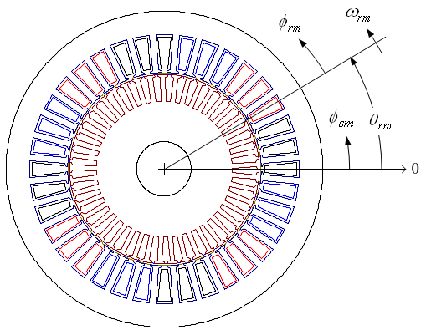
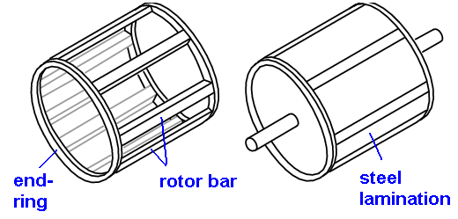
Assumptions
The flux density in the axial direction is zero
Hysteresis in the iron is neglected
Thermal conditions are assumed constant
No deformation occurs in stator and rotor teeth
Linear magnetics

Slide 5
Stator Basis Function Derivation
k_{ns}
k_{ts}

Slide 6
Rotor Basis Function (k_{nr},k_{tr}) Derivation
Impulse Response
1. Set a discrete-time impulse input to a
transient FEA program
i_{as}(t) = I₀ when t = t₀
i_{as}(t) = 0 when t ≠ t₀
2. Record the flux density components
(B_{nid}, B_{tid}) for t ≥ t₀.
3. Subtract the stator magnetic field
B_{nr}= B_{nid} – i_{as}k_{ns} , B_{tr}= B_{tid} – i_{as}k_{ts}
4. Divided by I₀
k_{nr}= B_{nr} / I₀ , k_{tr}= B_{tr} / I₀

Slide 7
Complete Characterization Process

Slide 8
Magnetic Flux Density Due to Stator
The flux density generated by arbitrary stator phase-a current is approximated as
Due to symmetry, the total flux density generated by stator currents

Slide 9
Magnetic Flux Density Due to Rotor
Obtain rotor magnetic field using the convolution of stator current signal and rotor basis function
due to i_{as}
due to i_{bs}
due to i_{cs}
where x can be ‘n’ or ‘t’

Slide 10
Complete Field Construction – Stator Current as Model Input
Obtain the total flux density in the discrete-time form
In the computer, the discrete convolution of the stator current and rotor basis function
where x can be ‘n’ or ‘t’

Slide 11
Voltage-Input-Based FC Technique
i
Current-input-based FC
Basic idea:
B_{n} , B_{t}
v
v → i
Stator voltage equations are used to relate voltage and current:
where ω is the angular speed of an arbitrary reference frame, and the flux linkages are expressed as
Due to the induced rotor current
Unknowns: L_{ss}, L_{ls}, λ_{qs,r}, λ_{ds,r}

Slide 12
Characterization of Rotor Basis Flux Linkage
Use the same FEA solutions as in the characterization of stator and rotor basis functions.
Impulse response (vector)

Slide 13
Calculate λ_{qs,r}, λ_{ds,r}
Procedure:
convolution.
transformation between reference frames
where θ_{r} is the electric rotor angle, and θ is the angle of the reference frame

Slide 14
Voltage-Input Based FC Diagram
Then i_{qd0s} → i_{abcs},
and i_{abcs} are then used in the current-input-based FC

Slide 15
An Induction Machine Fed By An Inverter
A sine-PWM modulation with 3rd-harmonic injection is used. The duty cycles for the three phases are

Slide 16
Challenges
Wide Range of Time Scales – (Switching Frequency versus Rotor Time Constant)
Resolution of n Hz requires a discrete-time simulation of 1/n second
For a simulation with step size h, the maximum frequency obtained using a discrete-time Fourier transform is 1/(2h)
Total number of sampling steps in the steady state that is required is 1/(nh)
Example:
Desired frequency resolution is 1 Hz
Step size is 10 μs
Total number of simulation steps required in steady state is 100,000.
The large size of rotor basis function and amount of sampling steps add difficulties to computer memory and the computational effort.

Slide 17
Computational Burden of FC
Dominated by Convolution
Assume Flux Densities are Calculated at p points in the Airgap with N samples

Slide 18
Multirate Field Construction
Partition Currents into Fast and Slow Components
Use ‘slow’ impulse response to calculate ‘slow’ component of flux density
Use ‘fast’ impulse response to calculate ‘fast’ component of flux density
In the slow subsystem, FC is used with sampling rate of :
Input − i_{as,lf} , i_{bs,lf} , i_{bs,lf}
Output − B_{n,lf ,} B_{t,lf}
Low Sampling Reduces Dimension of Convolution Matrix
In the fast subsystem, ‘Fast’ FC is used with sampling rate of :
Input − i_{as,hf} , i_{bs,hf} , i_{bs,hf}
Output − B_{n,hf ,} B_{t,hf}
Truncate ‘Fast’ Impulse Response at samples
Truncated Impulse Response Reduces Dimension of Convolution Matrix
Indeed Size of the Matrix Nearly Independent of Switching Frequency

Slide 19
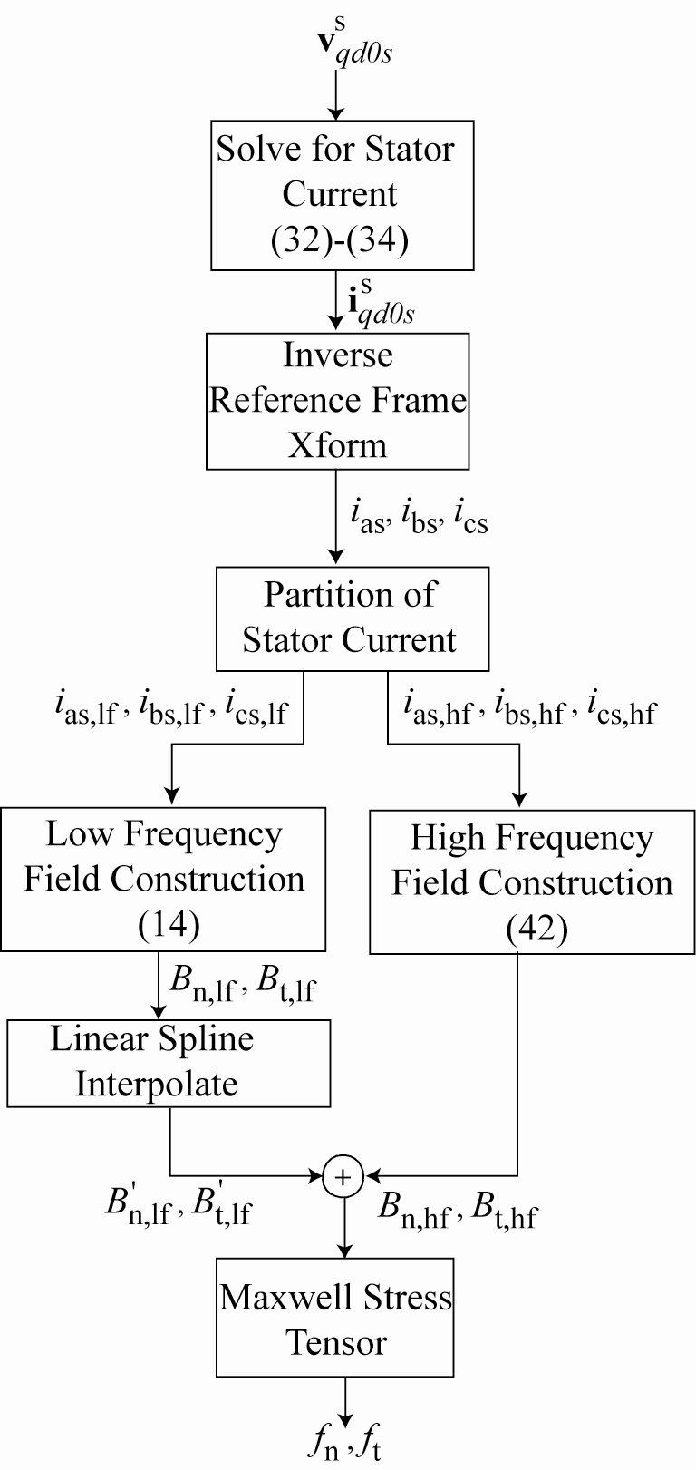
Multirate Field Construction
Low-frequency component i_{as,lf}
High-frequency component i_{as,hf}
Re-sampling i_{as}

Slide 20
Example Induction Machine Studied
3-phase 4-pole squirrel-cage induction machine
36 stator slots, 45 rotor slots
Rated power: 5 horsepower
Rated speed: 1760 rpm
r_{s} = 1.2 Ω
Machine parameters | Value
Airgap | 1.42 mm
Rotor outer diameter | 136.92 mm
Stator outer diameter | 228.6 mm
Stack length | 88.9 mm
Shaft diameter | 39.4 mm
Lamination material | M-19
Stator winding material | Copper
Rotor bar material | Aluminum
Number of turns per coil | 22
Number of coils per phase | 6 coils in series connection

Slide 21
Example Operating Conditions
ω_{rm}=1760 rpm
V_{dc} = 280 V
Sine-PWM modulation with 3rd harmonics injected
Switching frequency = 1 kHz (set low for FEA computation)
Step size of FC = 1 ms (slow subsystem),
0.01 ms (fast subsystem) (oversampled)
Nfast = 100 samples
B_{n,lf} = O(999 x 1000²) calculations/second
B_{n,hf} = O(999 x 100²) calculations/second
If used Single-rate FC = O(999x100000²) calculations/second
Step size of FEA = 0.01 ms

Slide 22
Result – Stator Current
FEA ~ 270 hours
FC ~ 48 minutes
f_{sw}-2f_{e}
f_{sw}-4f_{e}
f_{sw}+2f_{e}
f_{sw}+4f_{e}
i_{as}
Frequency spectrum of i_{as}

Slide 23
Result -- Torque
f_{sw}-3f_{e}
f_{sw}+3f_{e}
Torque
Frequency spectrum of Torque

Slide 24
Conclusions
Method to efficiently model fields and forces in inverter-fed induction machines presented
Requires Minimal FEA Evaluations (at Standstill)
Multi-rate Leads to Relatively Low Computation Burden
Does Not Increase with Switching Frequency
Can be Applied to Flux Density Field Construciton in Iron, i.e. Calculate Core Loss
Requires a Partition of Time Scales

Slide 25
Acknowledgement
This work is made possible through the Office of Naval Research Grant no. N00014-02-1-0623.

